Slide 1
Networking Configurations

Slide 2
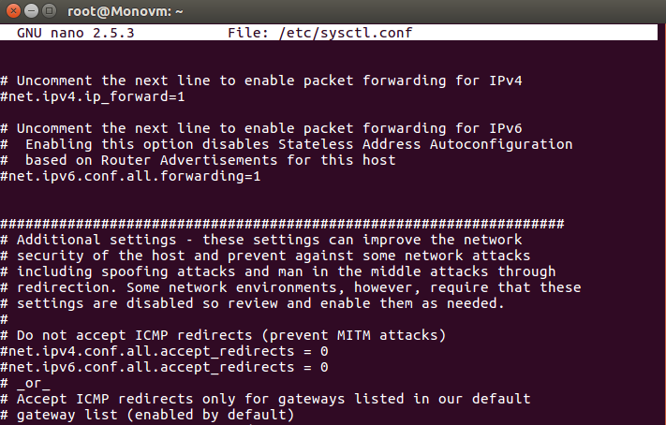
/etc/sysctl.conf
General networking security settings for the kernel in here
General syntax is [option] = 0 or 1
klaver.it is the move
Notes:
Majority of option have 0/1, some have more
Implemented by the sysctld program

Slide 3
Many options
IPv4 TCP SYN cookies (DoS attaccs)
net.ipv4.tcp_syncookies = 1
Preventing IP spoofing attaccs
net.ipv4.conf.all.rp_filter = 1
IPv4 TCP SYN,ACK retries
net.ipv4.tcp_synack_retries = 2
IPv4 forwarding
net.ipv4.ip_forward = 0
net.ipv4.tcp_max_syn_backlog = 4096
Notes:
Technique engineered to prevent DDoS attacks; allows server to avoid dropping conxns when queue filled up by acting as if queue is enlarged (reconstructs request); 1
When attacker masks as device on network to steal private data; 1 for enabling restricted mode (0 for no validation of source addr, 2 for loose mode; based on RFC 3074)
Goes along w/ SYN cookies; DoS attacks can be triggered using SYN floods (excessive amounts of SYN requests), leading to too many retries; should not be more than 255, default is 5 (<= 5)
IP forwarding - action which allows packets from one network travel to other networks; 0 for securing priv info

Slide 4
IPv4 TIME-WAIT assassination protection enabled
net.ipv4.tcp_rfc1337 = 1
IPV4 sending ICMP redirects
net.ipv4.conf.all.accept_redirects = 0
net.ipv4.conf.default.accept_redirects = 0
net.ipv4.conf.all.secure_redirects = 0
net.ipv4.conf.default.secure_redirects = 0
net.ipv6.conf.all.accept_redirects = 0
net.ipv6.conf.default.accept_redirects = 0
Most secure ASLR enabled
kernel.randomize_va_space = 2
Ignore broadcast ICMP echo requests
net.ipv4.icmp_echo_ignore_all = 1
IPv4 accept source routing
net.ipv4.conf.all.accept_source_route = 0
IPv6 disabled
net.ipv6.conf.all.autoconf=0
Notes:
TCP failures that are caused by duplicate segments in requests; 1
Specify better routing paths, incertain cases can be used to redirect to malicious networks; 0
Address Space Layout Randomization, prevents shellcode from being successful by offsetting location of modules (buffer-overflow attacks); 2 for Full Randomization
If pinged (ICMP echo), computer will respond, revealing location in network; 1
Mechanism that allows specification of route w/o referring route tables (should ultimately set rules for source routing), option can lead to network traffic redirecting for malicious purposes; 0
At rare instances, using IPv6 may lead to network problems since some computers still have not implemented it; 1

Slide 5
/etc/resolv.conf
Allows certain DNS servers to connect to host; can be used to fix DNS issues
Syntax:
nameserver [IP address]
Tip: Can use addresses to check your Internet conxns using ping cmd
Make sure you’re not connected to malo DNS server
Google DNS servers 8.8.8.8, 8.8.4.4,
Notes:
Malicious DNS servers can infiltrate data
8.8.8.8 and 8.8.4.4 are Google, 127.0.0.1 is loopback (ur own computer)

Slide 6
Ssave ur sysctl.conf
Sysctl -ep

Slide 7
/etc/resolvconf/resolv.conf.d
The folder itself
Contains other configuration files for resolving
./base
File containing basic resolver information. The lines in this file are included in the resolver configuration file even when no interfaces are configured.

Slide 8
/etc/hosts
Contains hosts that can be contacted without a name service (ex. DNS); creates aliases for IP addresses
Always has the loopback address 127.0.0.1 (aka localhost)
Needed to test server functionality
Ex: using loopback to test if Apache Guacamole is connecting to remote client
Notes:
Alias - alternative name; alternate way to connect to hosts
Guac is a remote client that can use ssh, rdp, vnc

Slide 9
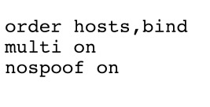
/etc/host.conf
Determines how hostnames are resolved
Order in which IP addresses are looked up
Multiple addresses can be read in hosts file
IP Spoofing
Notes:
Hosts refers to /etc/hosts, bind refers to your name server (DNS)
1st line - what if /etc/resolv.conf has bad DNS servers?
2nd - off may cause performance loss

Slide 10
/etc/hosts.deny
Blacklisting IP addresses that are not allowed to connect to the host

Slide 11
Firewall
Firewall protection has been enabled
The configs for these are in personalized file (/etc/ufw/sysctl.conf)
Notes:
Several; can be managed using ufw enable

Slide 12
Let’s review some concepts
sysctl.conf
General kernel + networking settings
resolv.conf
Determines what DNS servers can connect to host. Other files are in /etc/resolvconf/resolv.conf.d
hosts
Which hosts do not need to be searched for by DNS
host.conf
Configuration for resolving hostnames
hosts.deny
Blacklist of hosts that computer will not resolve

Slide 13
Networking cmds
yeeeee

Slide 14
ifconfig
interface config
interface means your network interface card
shows information such as your ip addr

Slide 15
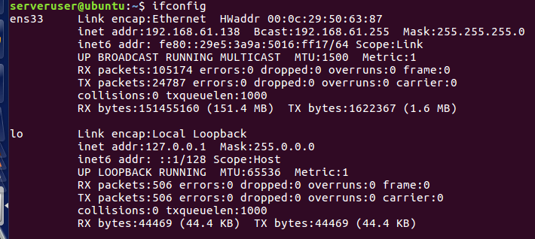
ifconfig cont
ens33 and lo = interfaces
HWaddr = MAC addr
inet addr = your dynamic IPv4 addr
127.0.0.1 is reserved for lo
Bcast = broadcast
Mask = subnet mask
inet6 addr = your dynamic IPv6 addr
Everything else is statistics

Slide 16
Just some reminders
When doing networking labs, check that you and your partner are on the SAME SUBNET
We are all using private IPs behind PAT!!
Check inet addr and mask in ifconfig

Slide 17
ping
Sends echo request to an IP addr
if you receive packets back from the IP, then you have network connectivity
Can check network connectivity during rounds
Ex: ping 8.8.8.8 (see if you can reach google)

Slide 18
traceroute
Similar to ping, except it shows each hop
Will show whether you have network connectivity + path to get to the IP specified

Slide 19
netstat
Network statistics
Tons of options, but netstat -tulpen is a pretty nice set to use
-l is for listening

Slide 20
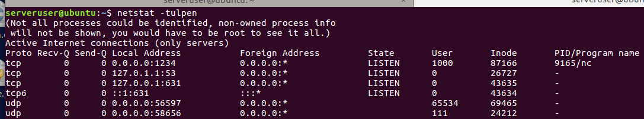
netstat ex:
This is the result of running netstat -tulpen after setting up nc -l 1234
Proto = protocol (tcp or udp)
Local address = [IP]:[port number]
Foreign address 0.0.0.0 means all IPs
PID/program name

Slide 21
nslookup
Allows you to parse DNS records
Ex: nslookup jimmyli.u returns 185.199.111.153

Slide 22
curl/wget
Retrieve a file from internet
Ex:
curl -O https://wordpress.org/latest.tar.gz
-O means redirect stdout to a file
wget wordpress.org/latest.tar.gz

Slide 23
nc (Netcat)
Swiss army knife of networking
Simplest connection (can do using 2 terminals on 1 VM)
Terminal 1: nc -l 1234
Terminal 2: nc localhost 1234
Anything entered in on T1 will be outputted to T2, vice versa

Slide 24
nc con’t
Uses:
Data transfer
Talking to servers
Port scanning
Try using man nc to see some cool nc examples

Slide 25
Pro network troubleshooting tips
Check connectivity first using ping
If ping fails, then you need to take action
sudo service network-manager restart
Check your resolv.conf to see that you have a valid DNS
8.8.8.8 always works :D
Can try renewing IP address using dhclient cmd

Slide 26
Credits
tdlp.org
linfo.org
manpages.ubuntu.com
Joseph’s Divine Wisdom
Notes:
Where’s the kahoot?
https://create.kahoot.it/details/81b9bcf0-4c9e-42a8-89b5-c042a38bc5e5

